Slide 1

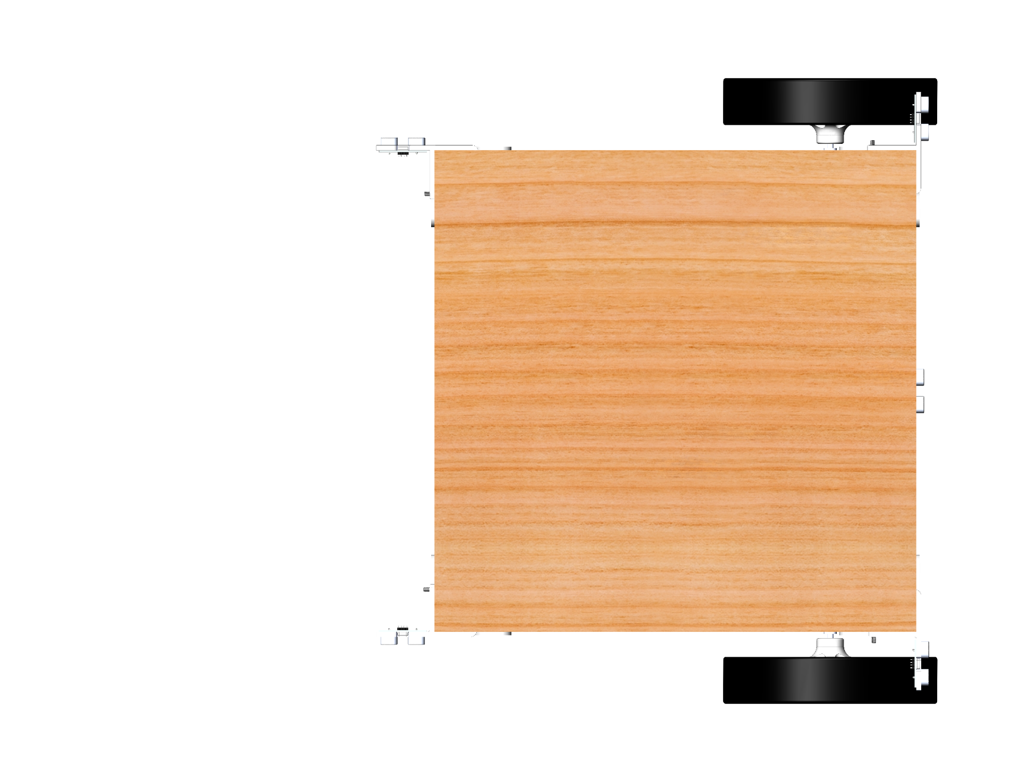
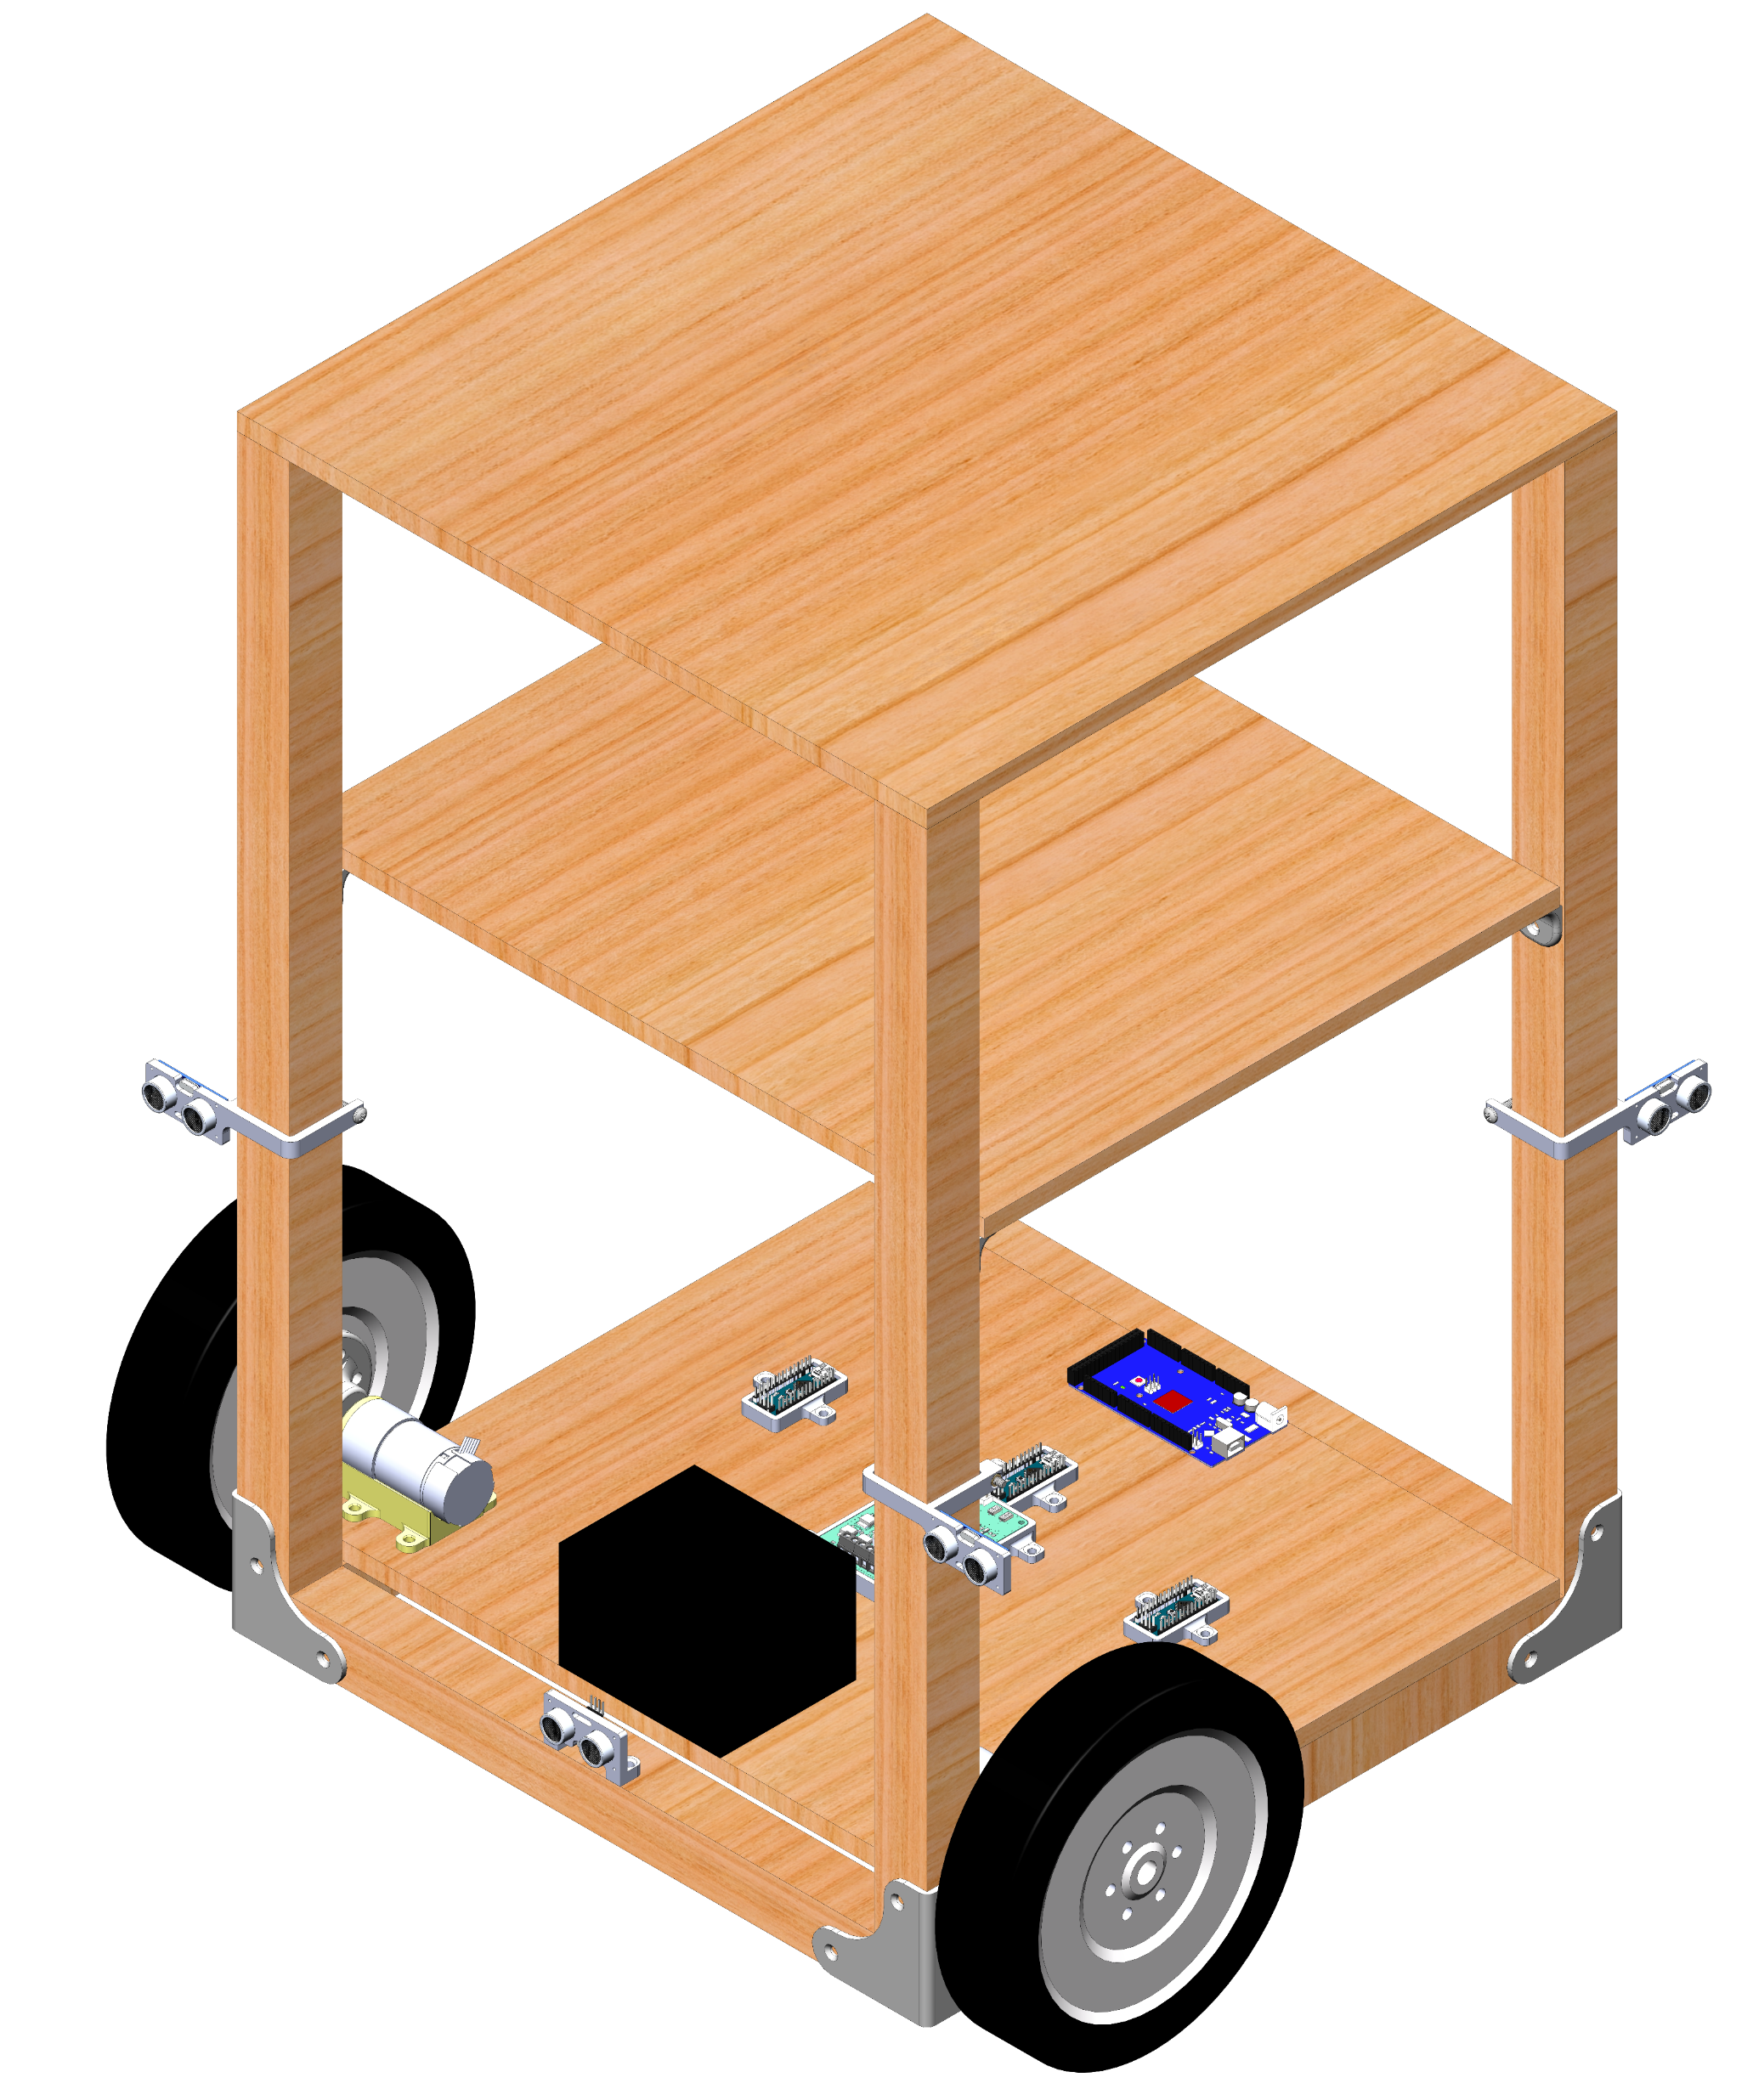
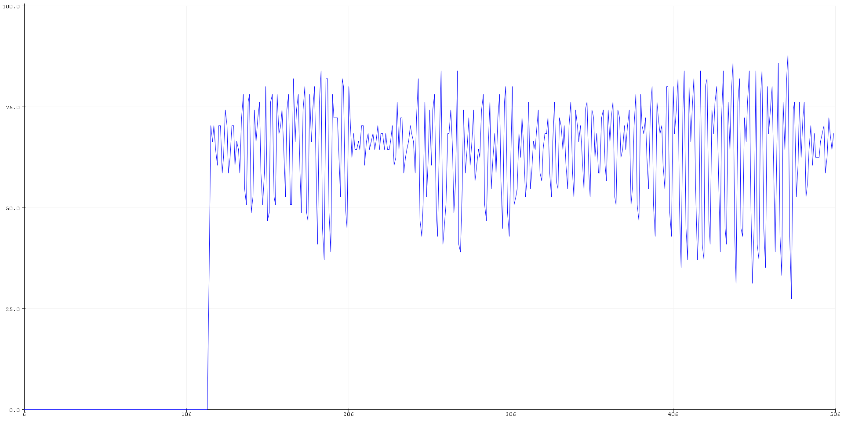
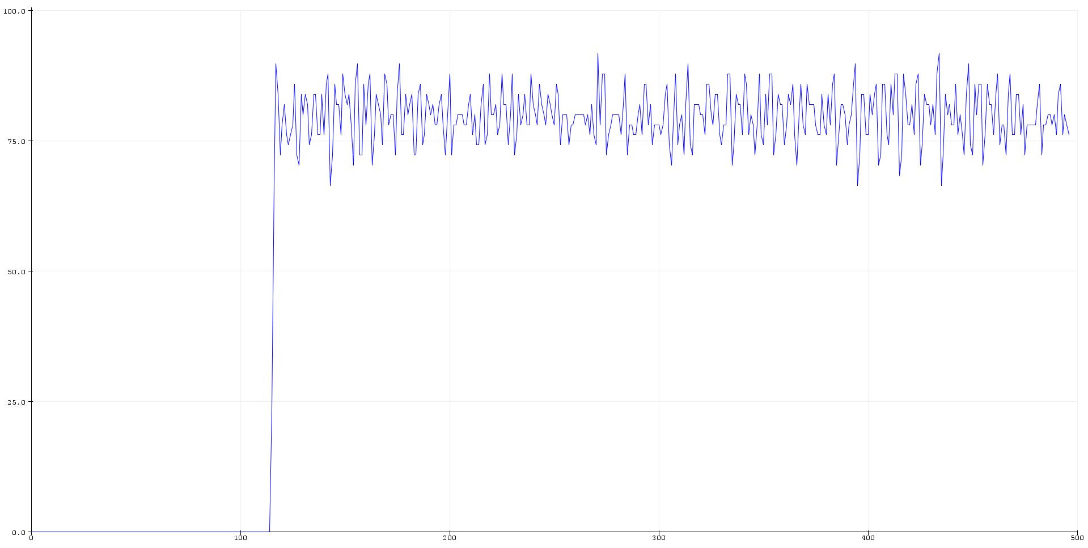
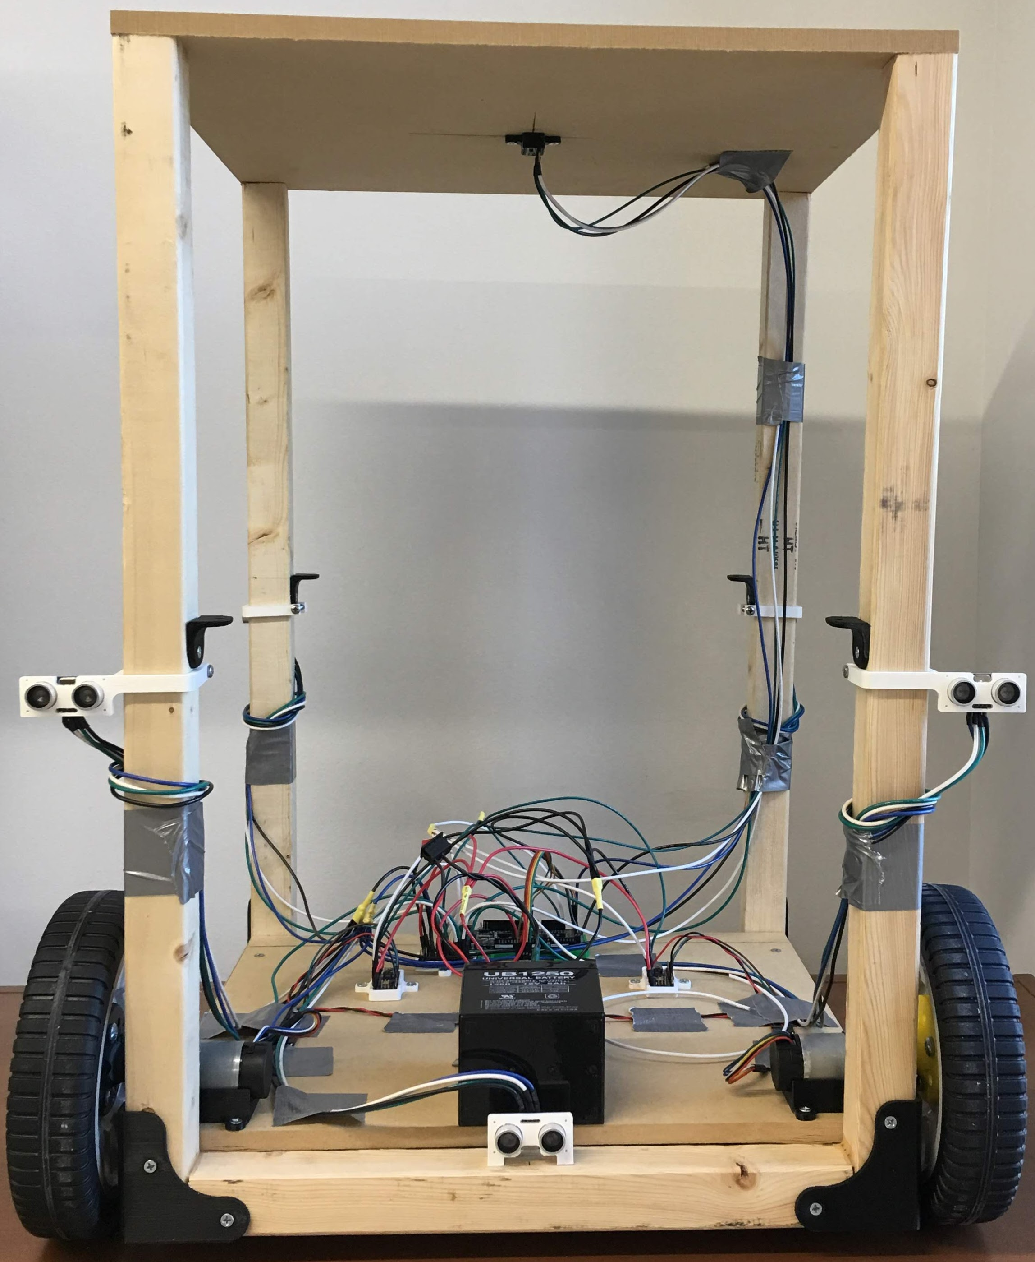
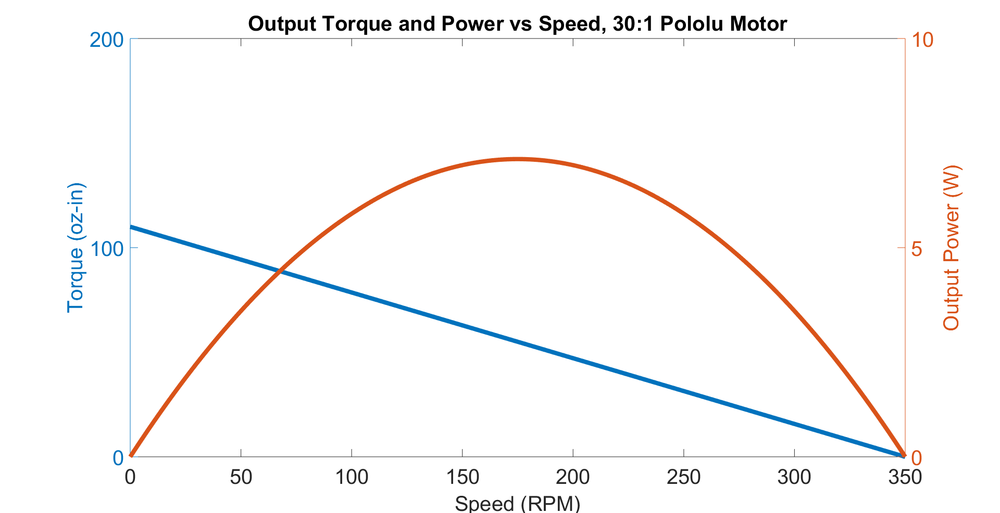
Design and Prototype of an Autonomous Shopping Cart
Siddharth Kurwa, Cockrell School of Engineering, siddharth.kurwa@gmail.com, Fall 2018
Background
Control System Architecture
Obstacle Avoidance Logic
Since the invention of the first shopping cart in 1937, there have only been modest updates to the device design driven by innovation in materials and manufacturing processes. With modern advances in sensing and mechatronics, the shopping cart is prime for a redesign that leverages these technologies.
Disturbance
+
+
+
PID
Left motor
+
Heading setpoint
-
PID
-
-
4
5
6
Project Goals
Encoder feedback
This project’s goal was to build a functional prototype of a motorized cart with storage volume and the capacity to avoid and navigate around obstacles. This system will serve as a platform to develop, prototype, and test features towards a fully-fleshed autonomous shopping cart.
Fully implemented, an autonomous shopping cart will consist of the following features:
Offers storage volume comparable to standard shopping carts
Motion plans around obstacles
Follows shopper around store
Automatically scans items placed into the cart
Provides a payment terminal for shopping
Speed setpoint
+
PID
Right motor
-
3
Encoder feedback
Obstacle
7
Compass feedback
2
8
1
9
Closed-loop speed control is achieved with encoder feedback of each motor. A magnetometer compass provides closed-loop heading control.
Mechanical Design
Proportional Controller
(K_{p} = 4)
PID Controller
(K_{p} = 2.4, K_{I} = 6, K_{D} = 0.006)
Step Input
Step Input
Cart approaches obstacle and forward proximity sensors detect obstacle.
Cart performs a 90° turn using gyro feedback.
Cart moves forward until rear right proximity sensor crosses obstacle.
Cart performs a -90° turn using gyro feedback.
Cart moves forward until rear right proximity sensor crosses obstacle.
Cart performs -90° turn using gyro feedback.
Cart moves forward until rear right proximity sensor detects obstacle.
Cart performs a 90° turn using gyro feedback.
Cart resumes initial path.
Steady-state error
Wheel Velocity (RPM)
Grocery storage
Conclusions and Future Improvements
Motor driver
Arduinos
Time (ms)
The semester’s project goals have been achieved as the functional prototype performs obstacle avoidance, carries groceries, and offers sufficient onboard processing power to enable testing and implementation of new features.
Improvements to make to the existing system:
Add a bearing block on the motor shaft to reduce shaft bending and shear loads.
Mount ultrasonic sensors on a continuous servomotor to provide 360° proximity detection, eliminating existing blind-spots.
Develop smoother path-planning around obstacles rather than solely 90° turns.
New features to incorporate:
Indoor localization sensing using off-the-shelf options like PixyCam, Bluetooth transmitters/receivers, and Wi-Fi.
RFID sensors and onboard payment terminals.
The Ziegler-Nichols method was applied to tune the motor PID controllers. This method uses a proportional controller to experimentally estimate optimal PID parameters (K_{P}, K_{I}, and K_{D}) that reduce oscillation, eliminate steady-state error, and maintain system stability.
Distributed Computing over I²C Network
DC gearmotor
Proximity sensor measurement and setpoint determination,
Arduino Nano (slave),
Polling at 4 Hz
Sealed lead acid battery
Ultrasonic proximity sensors
Wheel velocity setpoints
The wheel base was modeled on a differential drive robot with one driven caster and two driving wheels. The controllers, power storage, and drive units are all stored on the bottom platform to maximize usable grocery storage volume. This functional prototype has a wooden construction with 3D-printed brackets, fixtures, mounting adapters, and wheel hubs.
PID controller,
Arduino Mega (master),
Polling at 20 Hz
Measured
velocity
Measured
velocity
Left wheel drive signal
Right wheel drive signal
Acknowledgements
Left wheel velocity measurement and motor drive,
Arduino Nano (slave),
Event-driven up to 6000 Hz
Right wheel velocity measurement and motor drive,
Arduino Nano (slave),
Event-driven up to 6000 Hz
I deeply appreciate Dr. Carolyn Seepersad’s support through the semester. Her advice and feedback were instrumental in executing this project.
Further Information
At a normal walking speed, each encoder clicks at 3500 Hz. The proximity sensor array can poll at a maximum of 4 Hz. If tasks were handled in series, the PID loop rate would be limited by the slowest polling process (4 Hz), creating transport delay in the control system. To improve system stability by minimizing transport delay, computational tasks were distributed over 4 Arduino microcontrollers and communicated over I²C protocol. By managing tasks in parallel, the control system was able to achieve a 20 Hz PID loop rate.
CAD, source code, BOM, documentation: https://github.com/skurwa/smart-cart
To learn more about Sid: https://skurwa.github.io
Based on torque-speed analysis, the DC gearmotor was appropriately sized to handle max torque loads from a 25 lb cart load, human walking speed (5 ft/s), 1 ft/s² acceleration, 0.25° incline, and 70% efficiency.
References
Zafari, F., Gkelias, A., & Leung, K. K. (2018). A Survey of Indoor Localization Systems Technologies
(Rep. No. 1709.01015). https://arxiv.org/pdf/1709.01015.pdf

